Slide 1
Secure Data Hiding in Image Using Steganography
Presented By:
Student Name : Vepada Sri Charan
College Name & Department : Raghu Engineering College, CSE(Cyber Security)

Slide 2
OUTLINE
Problem Statement
Technology used
Wow factor
End users
Result
Conclusion
Git-hub Link
Future scope

Slide 3
Problem Statement
Traditional data hiding techniques lack security and integrity, making hidden information vulnerable to unauthorized access and modifications. This project combines steganography with cryptography to ensure confidentiality and authenticity of hidden messages in images. Additionally, a digital signature mechanism is used to verify message integrity, preventing tampering.

Slide 4
Technology used
Programming Language: Python 3.x
Libraries:
Pillow – Image processing
Cryptography – AES encryption & decryption
Hashlib – Digital signature for integrity verification
Platform: Works on Windows, Linux, and macOS

Slide 5
Wow factors
Dual-layer Security: Combines Steganography + AES Encryption for enhanced data protection.
Digital Signature Verification: Ensures message integrity, detecting any tampering.
User-defined Encryption Key: Allows custom key input, making decryption exclusive to authorized users.
Fully Automated Process: Encodes, encrypts, and verifies without manual intervention for seamless security.
Cross-Platform Compatibility: Works on Windows, Linux, and macOS without modifications.

Slide 6
End users
End Users:
Cybersecurity Professionals – For secure communication and data protection.
Journalists & Whistleblowers – To hide sensitive information from unauthorized access.
Forensic Experts – For secure evidence storage and transmission.
Government & Defense Agencies – To exchange confidential data securely.
General Users – Anyone needing private and tamper-proof message hiding.

Slide 7
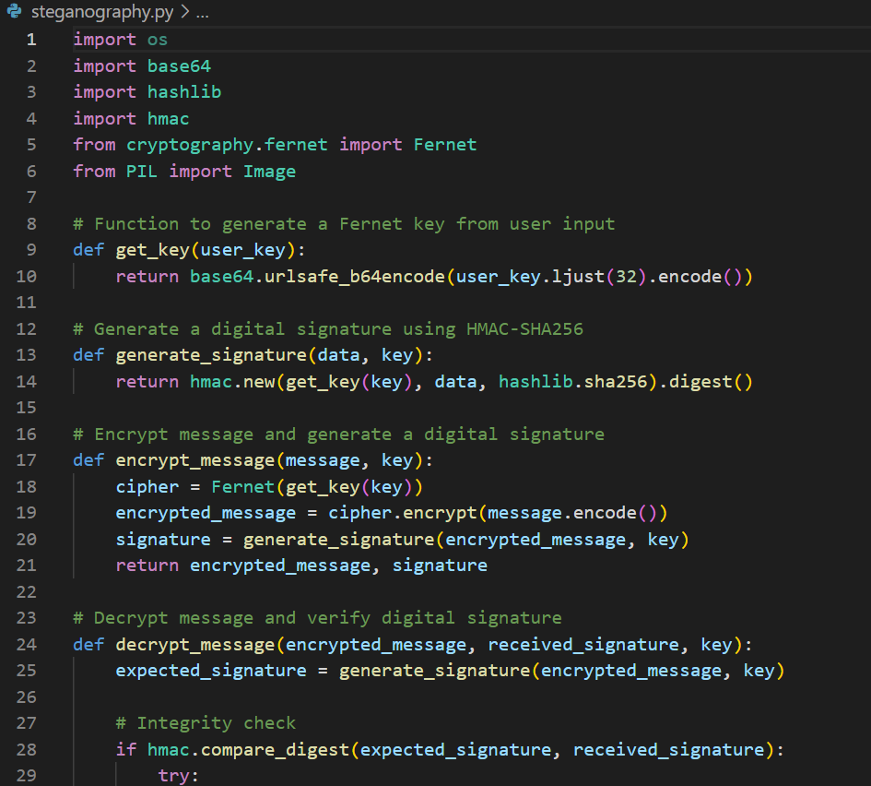
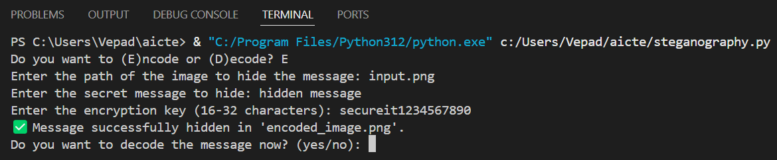
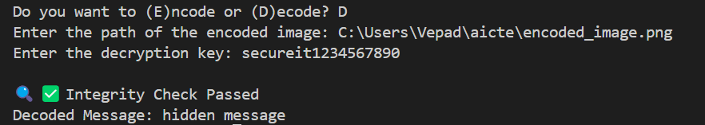
Results
Source code
Encoding
Decoding

Slide 8
Conclusion
This project successfully addresses the security and integrity challenges in data hiding by integrating steganography, encryption, and digital signature verification. By combining AES encryption with LSB-based image steganography, the hidden message remains confidential and tamper-proof. The digital signature mechanism ensures message authenticity, making it a robust and secure approach for covert communication. This solution enhances data protection and can be effectively used in cybersecurity, forensics, and confidential communication.

Slide 9
GitHub Link
https://github.com/VepadaSriCharan/Steganography.git

Slide 10
Future scope(optional)
Support for Multiple File Formats – Extend beyond images to hide data in audio, video, and PDFs.
Advanced Encryption Techniques – Implement quantum-resistant cryptographic algorithms for enhanced security.
AI-Based Steganalysis Resistance – Develop methods to evade detection from AI-powered steganalysis tools.
Cloud Integration – Securely encode and decode hidden messages via a cloud-based platform.
Mobile Application – Create a user-friendly mobile app for easy steganography on smartphones

Slide 11
THANK YOU

